Slide 1
Substance Abuse

Slide 2
Please click on the link provided and watch the video “Anyone Can Become Addicted” by the National Institute on Drug Abuse
https://youtu.be/wCMkW2ji2OE

Slide 3
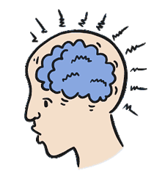
Let’s Test Your Knowledge…
True or False
According to the video, Addiction is a disease of the brain.

Slide 4
The correct answer is….

Slide 5
NEXT QUESTION
TRUE OR FALSE
It depends on your age, gender, job, income and race as to if someone becomes addicted to drugs or not.

Slide 6
AND THE ANSWER IS…

Slide 7
NEXT QUESTION
TRUE OR FALSE
Prescription drugs can never become addictive.

Slide 8
AND THE ANSWER IS….
FALSE

Slide 9
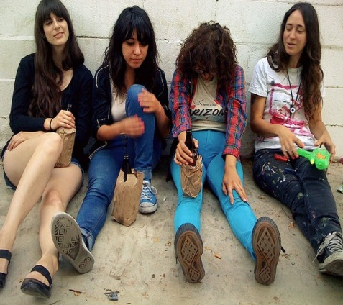
NEXT TO THE LAST QUESTION
What are the four factors that put someone at a higher risk of abusing and becoming addicted to drugs?
Here are some hints:

Slide 10
DID YOU GET ALL FOUR ANSWERS?
Having family members with drug/substance abuse problems.
Hanging around with others that use drugs/substances.
Having mental health problems.
Using drugs/substances at a young age.

Slide 11
How do you recognize unhealthy drug use in others?

Slide 12
Signs of unhealthy drug use include:
Problems at work
Issues with physical health
Neglected appearance/hygiene
Changes in behavior
Financial issues
Notes:
Signs and symptoms of substance use or intoxication can vary depending on the type of substance

Slide 13
Problems at work
Frequently late or absent
Lack of interest in work activities
Decreased work performance

Slide 14
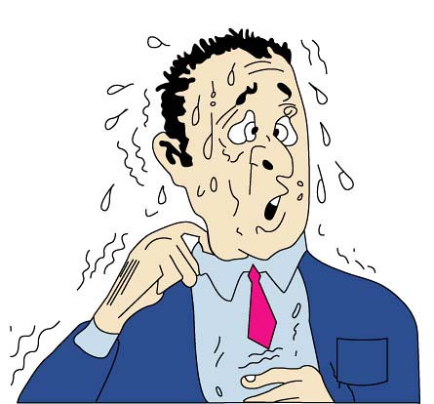
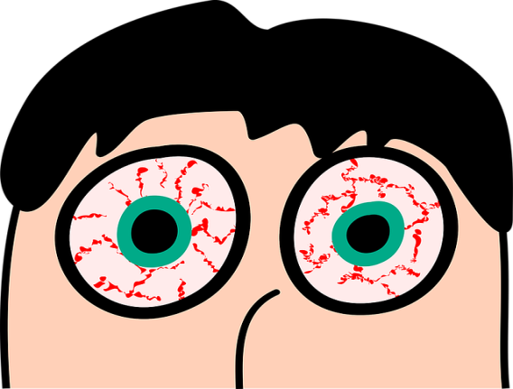
Issues with physical health
Decreased energy and increased fatigue
Decreased motivation
Change in weight (loss or gain)
Frequent nausea/vomiting or diarrhea
Change in physical appearance (red eyes, sweating, paleness, flushed)

Slide 15
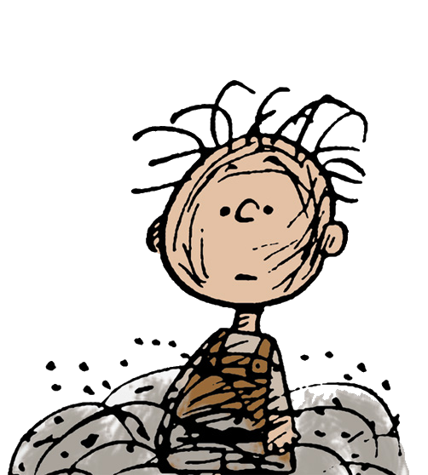
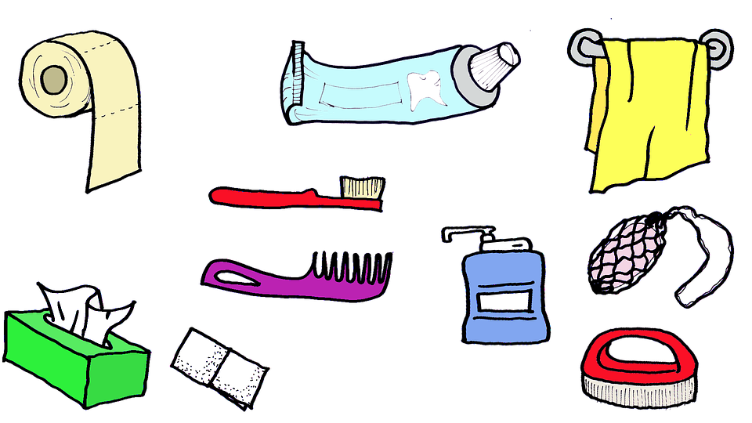
Neglected appearance/hygiene
Clothing
Grooming
Body odor

Slide 16
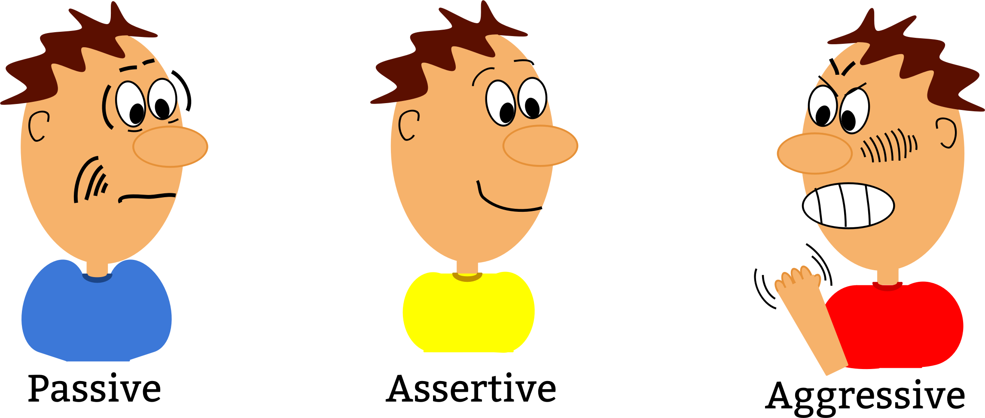
Changes in Behavior
Secretive
Drastic relationship changes
Drastic behavior changes

Slide 17
Financial Issues
Request for money without valid explanation
Missing money
Missing items

Slide 18
What are commonly
used and abused substances?

Slide 19
Commonly used/abused substances
Cannabis
K2, Spice, Bath Salts (Synthetics)
Barbiturates
Benzodiazepines
Hypnotics
Stimulants
Opiates

Slide 20
The following slides address commonly used/abused substances in more detail. Their purpose is to help you know how the substances are used by others and the signs/symptoms of recent use.

Slide 21
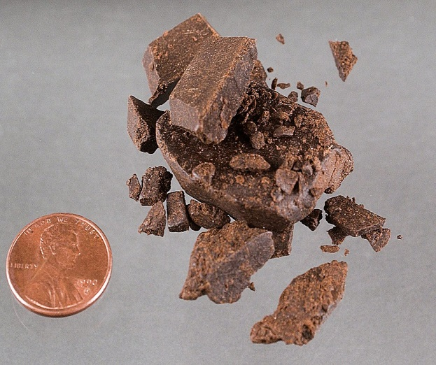
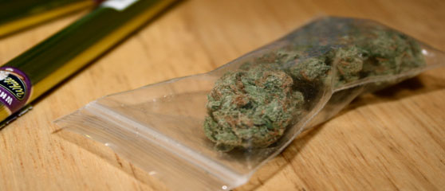
Cannabis (Marijuana, Hashish)
How it is used:
Smoking
Eating
Inhaling Hashish
Marijuana

Slide 22
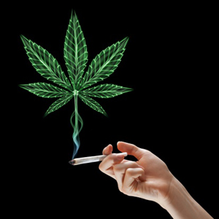
Cannabis (Marijuana, Hashish)
Signs/Symptoms of Recent Use
Euphoria/ Feeling “high”
Heightened senses (visual, taste, auditory)
Increased BP and heart rate
Red eyes
Dry mouth
Decreased coordination
Difficulty concentrating or remembering
Slowed reaction time
Anxious/paranoid
Cannabis odor on clothes
Exaggerated food cravings

Slide 23
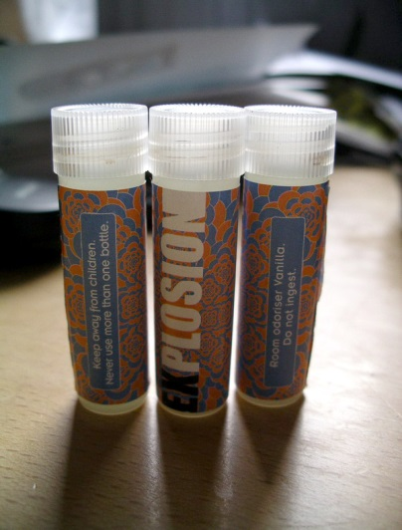
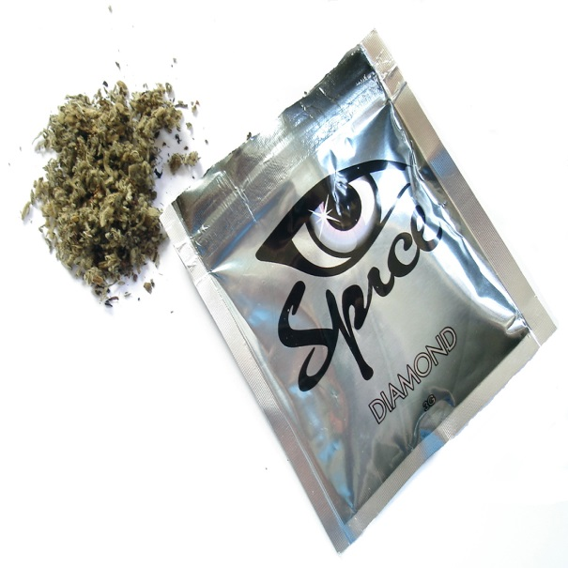
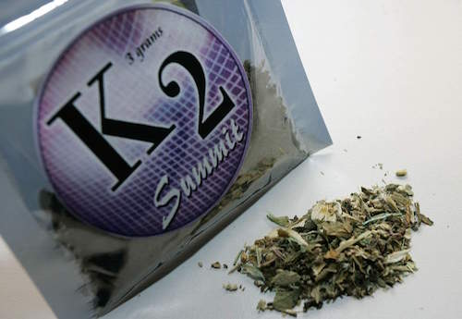
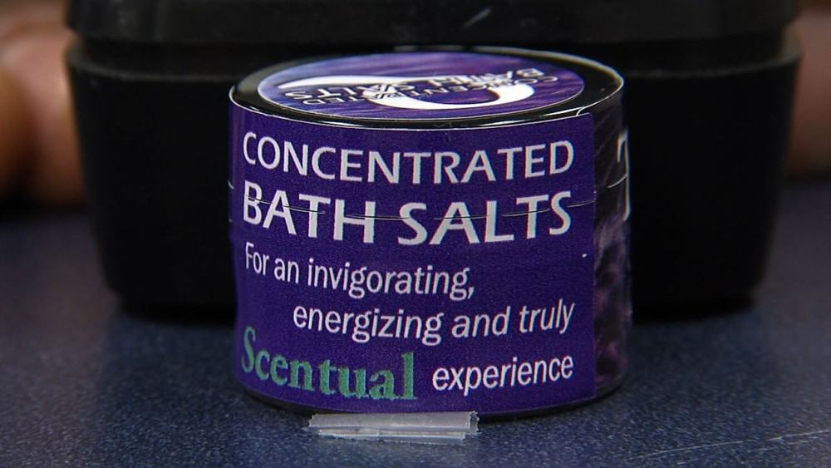
K2, Spice, Bath Salts
Synthetic Cathinones “Bath salts” (mind altering and highly addictive)
Synthetic Cannabinoids “K2 or Spice”
How it is used:
Sprayed on dried herbs
Smoked
Drank (prepared in herbal tea)
How it is used:
Eaten
Snorted
Inhaled
Injected
Notes:
Illegal in WV
Effects are unpredictable and dangerous because there is no quality control and ingredients aren’t always known

Slide 24
K2, Spice, Bath Salts
Signs of recent use of K2/Spice
Signs of recent use of bath salts
Euphoria/feeling “high”
Elevated mood
Altered sense of visual, auditory, and taste perception
Extremely anxious or agitated
Paranoid
Hallucinations
Increased heart rate and blood pressure (heart attack)
Vomiting
Confusion
Euphoria
Increased sociability
Increased energy and agitation
Increased sex drive
Increased heart rate and blood pressure
Difficulty thinking clearly
Loss of muscle control
Paranoia
Panic attacks
Hallucinations
Delirium
Psychotic and violent behavior

Slide 25
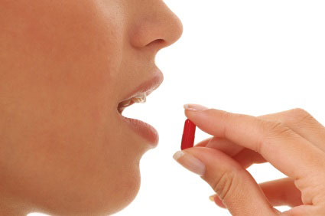
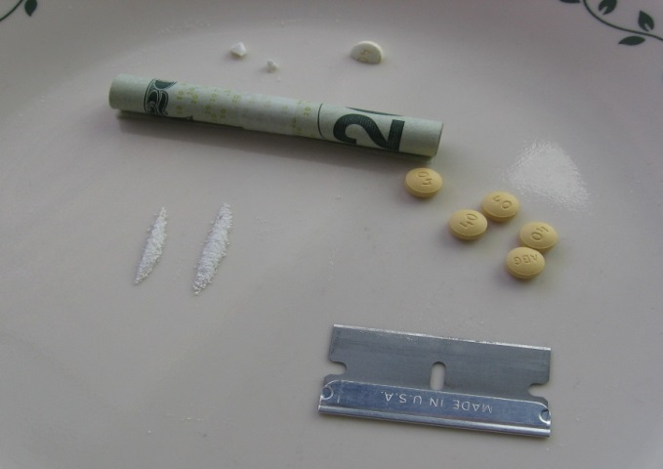
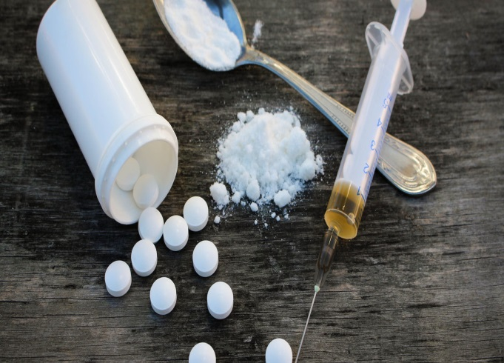
Barbiturates, benzodiazepines, and hypnotics
How they are used:
Oral
Snorted
Injected
Notes:
Prescription medications that depress the central nervous system. Used to relax or forget stressful thoughts feelings
Barbiturates: phenobarbital, secobarbital
Benzo: Valium, Xanax, Ativan
Hypnotics: Ambien (sleeping medications)

Slide 26
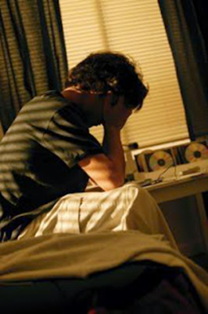
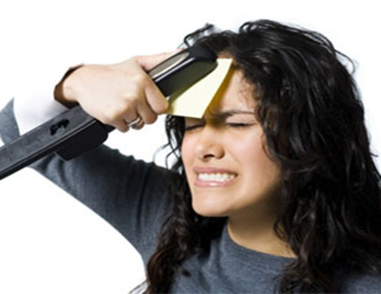
Barbiturates, benzodiazepines, and hypnotics
Signs of recent use
Tired and drowsiness
Slurred speech
Lack of coordination
Mood changes or irritability
Difficulty concentrating or thinking clearly
Difficulty remembering
Lack of inhibition
Slowed breathing and reduced BP
Accident prone/falling
Dizziness

Slide 27
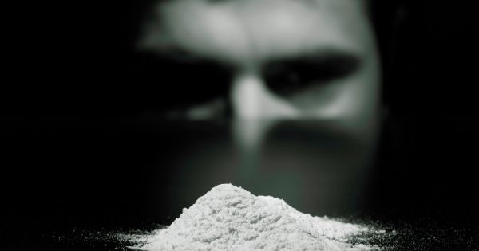
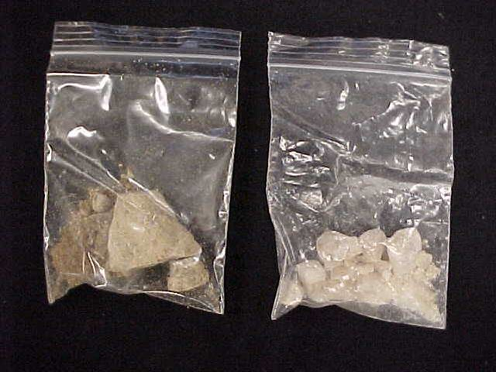
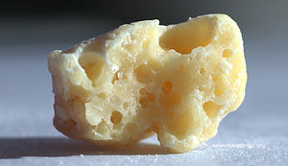
Meth, Cocaine, and other stimulants
How is it used
Cocaine
Crack Cocaine
Oral
Smoked
Snorting/inhalation
Injection
Methamphetamine
Notes:
Used to get high, boost energy, improve work performance, or lose weight or control appetite.

Slide 28
Meth, Cocaine, and other stimulants
Signs of recent use:
Exhilarated and increased confidence
Increased alertness
Increased energy and restlessness
Exaggerated emotions/motions
Behavior changes or aggression
Rapid or rambling speech
Dilated pupils
Confusion, delusions, hallucinations
Changes in heart rate, BP, and body temp
Nausea or vomiting
Impaired judgement
Nasal congestion
Mouth sores
Sores
Insomnia
Depression as drug wears off

Slide 29
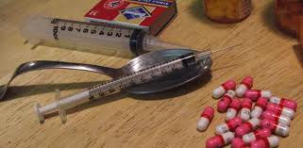
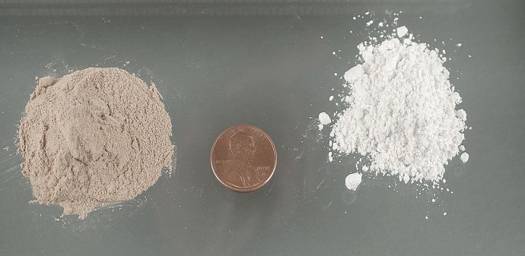
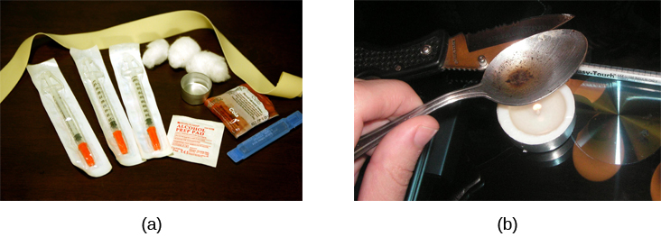
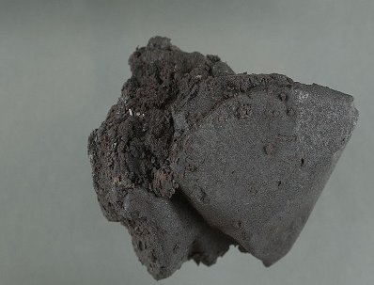
Opiates/Opioids
How it is used:
Oral
Snorting
Injection
Heroine
Notes:
Opiates are derived from opium plant (heroine, morphine, codeine)
Opioids are synthetic opiates (Fentanyl and oxycontin hydrocodone, methadone) Also used for the entire family of opiates natural, synthetic, and semi-synthetic)

Slide 30
A better understanding of what happens to the brain on opioids
Please click the link and watch this
short but informative film by National Geographic.
https://www.youtube.com/watch?v=NDVV_M__CSI

Slide 31
Opiates/Opioids
Coordination issues
Depression
Confusion
Constipation
Runny nose
Needle marks
Signs of recent use
Reduced sense of pain
Agitation, drowsiness or sedation
Slurred speech
Problems with attention and memory
Constricted pupils
Lack of awareness or inattention to people and things around them

Slide 32
FACTS about opioid use in the United States

Slide 33
How to recognize a possible opioid overdose
Face is extremely pale and/or feels clammy to touch
Body goes limp
Fingernails or lips are purple or blue in color
Vomiting or making gurgling noises
Can’t be awakened or unable to speak
Breathing or heartbeat slows or stops
Notes:
Administer Narcan and/or immediately call 911

Slide 34
IN THE EVENT OF A POSSIBLE
OPIOID OVERDOSE

Slide 35
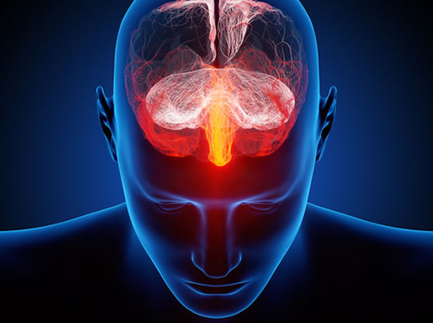
Why are drugs so hard to quit?
Please click the link below and watch this short video by the National Institute on Drug Abuse.
https://www.youtube.com/watch?v=Xbk35VFpUPI&feature=youtu.be

Slide 36
If you suspect that someone is under the influence of a substance DO
Follow your office’s policies and procedures.
Call for assistance (Supervisor, Director or Coworker)
Remain calm and take a deep breath
Position yourself for safety (Attempt to move yourself towards an outlet in the event it is needed)
Avoid the Danger Zone - within one arm length ◦
Safety Zone – Out side of person’s reach ◦
Remain in the Zone of Influence – Within Safety Zone, but still close enough to communicate effectively ◦
Use Natural Barriers (desks, chairs, etc.)
Be mindful of your body language
Maintain eye contact
Maintain a neutral facial expression
Relax your body and keep your gestures to a minimum

Slide 37
If you suspect that someone is under the influence of a substance DON’T
Rush the conversation.
Have an emotional reaction.
Take comments personally.
Go right to empathy or problem-solving.
Use sarcasm or humor.
Confront, criticize or blame.
State judgments about statements or
behaviors.

Slide 38
If you suspect that someone is under the influence of a substance and you believe that your safety or the safety of others is at risk…..

Slide 39
What do you do if you find drugs or drug paraphernalia in your workplace?
SAFETY is the main priority. If you feel your safety or the safety of others is at risk, CALL 911.
If you are unable to identify the substance, DO NOT pick it up. Wait for law enforcement.
Do not handle any substance or paraphernalia without exercising universal precautions. Be sure to use gloves if you must touch it.
If you choose to remove a substance from it’s original location, place it in a baggie and give it to law enforcement when they arrive.
If the substance or paraphernalia is located in a public setting such as a lobby or bathroom, have someone secure the area until law enforcement arrives.
When in doubt, CALL 911 or local law enforcement.

Slide 40
Know your company’s policies related to drug and alcohol use.
Click the link below to review River Valley’s
Drug and Alcohol Free Environment Policy
https://cd8935a7-40b5-40cb-abea-a67607b43c5c.filesusr.com/ugd/20e556_e817ac6ef6694616b84ec9a73e8eeeea.pdf

Slide 41
Test Your Knowledge
True or False
And the answer is…
RVCDS, recognizes that the use and/or abuse of controlled substances and alcohol does not present a serious threat to the safety and health of the individual employee/volunteer, the general public, and the children and families served by RVCDS.
The RVCDS Drug and Alcohol Free Policy only applies to employees.
The policy prohibits the abuse of prescription and over the counter drugs .
This policy applies to any time while working on RVCDS’ behalf or at any time while on the premises or while attending agency sponsored training sessions or meetings.
Refusing to submit to drug and/or alcohol testing including failure to appear for any test within a reasonable time established by RVCDS is reason for disqualification from further consideration for employment or termination from current employment.
False
False
True
True
True

Slide 42
What do you do if you suspect your coworker is using substances?
Do not approach your coworker directly.
Notify your Supervisor or Director of your suspensions and provide proof to support your claims.
You may also contact your Human Resources Director for further guidance.
Joshua MacAdoo
(304) 522-3417 Ext. 3435

Slide 43
What should you do if you think you may have an issues with drugs and/or alcohol?
SAMHSA’s National Helpline,
1-800-662-HELP(4357)
National Drug Helpline
1-844-289-0879
HELP4WV
(304)-356-5840
WV Bureau for Behavioral Health & Health Facilities
(304) 558-1008
Alcoholics’ Anonymous (AA)
www.aa.org
Narcotics' Anonymous (NA)
http://www.na.org
RESOURCES
Talk to someone you can trust
Speak with your Director of Human Resources to determine eligibility for various programs
Utilize community mental health and substance abuse resources
GET HELP

Slide 44
Works Cited
Community Mental Health Authority of Clinton, Eaton, Ingham Counties. (n.d.). De-Escalation Skills. Retrieved 2018
King, K. (2014). Mental Illnesses & Crisis De-escalation. NAMI: Minnesota.
National Institute on Drug Abuse. (2018, November). Opioid Abuse and Addiction. (U. S. National Library of Medicine) Retrieved from Medline Plus: Trusted Health Information for You: https://medlineplus.gov/opioidabuseandaddiction.html
National Institute on Drug Abuse. (n.d.). Easy-to-Read Drug Facts. Retrieved 2018, from National Institute on Drug Abuse: https://easyread.drugabuse.gov/content/what-are-some-signs-and-symptoms-someone-drug-use-problem
Staff, M. C. (1998-2018). Drug Addiction (Substance Use Disorder). (Mayo Foundation for Medical Education and Research (MFMER)) Retrieved 2018, from Mayo Clinic: https://www.mayoclinic.org/diseases-conditions/drug-addiction/symptoms-causes/syc-20365112

