Slide 1
Embedding the NAEYC Code of Ethics in Everything You Do

Slide 2
Objectives
Identify the four areas of responsibilities addressed in the Code of ethics
Link code of ethics to specific ideals
Link code of ethics to specific behaviors

Slide 3
Have you ever wondered why a code of ethical conduct is needed?
Let’s take a look…

Slide 4
Notes:
https://www.youtube.com/watch?v=-gRLHf6ZBM4

Slide 5
Definitions
Ideals – are goals of the professional to the targeted group
Principles – How goals might be accomplished and what type of behavior might be necessary
Ethical Dilemma- A dilemma requires a person to choose between two actions, each having some benefits but also having some costs.
Ethical Responsibility - Ethical responsibilities are mandates that are clearly spelled out in the NAEYC Code of Ethical Conduct —they describe how early childhood educators /professionals are required to act and what they must do

Slide 6
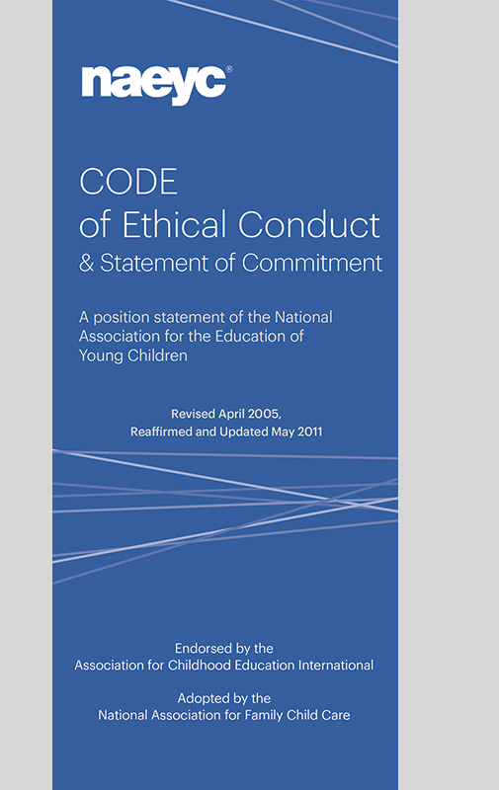
NAEYC Code of Ethical Conduct
Areas of Responsibilities
Ethical Responsibilities to Children
Ethical Responsibilities to Families
Ethical Responsibilities to Colleagues
Ethical Responsibilities to Community and Society

Slide 7
Responsibilities to Children

Slide 8
Responsibilities to Children
We are committed to supporting children’s development and learning; respecting individual differences; and helping children learn to live, play, and work cooperatively. We are also committed to promoting children’s self-awareness, competence, self-worth, resiliency, and physical well-being.

Slide 9
Ideals
We must abide by the following Ideals:
1.1 -To be familiar with the knowledge base of early childhood care and education and to stay informed through continuing education and training.
1. 9 - To advocate for and ensure that all children, including those with special needs, have access to the support services needed to be successful.

Slide 10
Principles
P 1.8—We shall be familiar with the risk factors for and symptoms of child abuse and neglect, including physical, sexual, verbal, and emotional abuse and physical, emotional, educational, and medical neglect. We shall know and follow state laws and community procedures that protect children against abuse and neglect.
P-1.3—We shall not participate in practices that discriminate against children by denying benefits, giving special advantages, or excluding them from programs or activities on the basis of their sex, race, national origin, immigration status, preferred home language, religious beliefs, medical condition, disability, or the marital status/family structure, sexual orientation, or religious beliefs or other affiliations of their families.

Slide 11
Is this an Ethical Dilemma ?
Families who previously had children enrolled in a nearby program have shared with you some negative things that happened to their children in that center. They describe dirty sheets on the cots, harsh punishments including withholding food, and ratios of twenty children to one adult. One day you drive by and see a lot covered with asphalt and dry grass. There are a few rusting pieces of playground equipment. Several children are standing along the chain link fence looking at the cars going by. There are no adults in sight.

Slide 12
This scenario falls under Ethical Responsibility as Early Childhood professionals are mandated by the Code of Ethics to report child abuse and neglect .
Answer:
No

Slide 13
Principles for Scenario
P-1.9—When we have reasonable cause to suspect child abuse or neglect, we shall report it to the appropriate community agency and follow up to ensure that appropriate action has been taken. When appropriate, parents or guardians will be informed that the referral will be or has been made.
P-1.10—When another person tells us of his or her suspicion that a child is being abused or neglected, we shall assist that person in taking appropriate action in order to protect the child.

Slide 14
Responsibilities to Families

Slide 15
Responsibilities to Families
Leaving a child in the care of an outsider is a difficult decision for a family to make. In a perfect world, children would be born with parents who knew exactly what to do to raise the perfect child and have all the money and resources to do so. The reality is that children do not come with instruction manuals. Families need to work or have obligations that require them to access childcare outside the home. Therefore, it is the early childhood professional’s obligation to follow these Ideals:

Slide 16
Ideals
I-2.2—To develop relationships of mutual trust and create partnerships with the families we serve.
I-2.4—To listen to families, acknowledge and build upon their strengths and competencies, and learn from families as we support them in their task of nurturing children.

Slide 17
Principle
P-2.5—We shall make every effort to communicate effectively
with all families in a language that they understand.
We shall use community resources for translation and interpretation when we do not have sufficient resources in our own programs.

Slide 18
Sticky Situation Scenario
If you and your spouse are out shopping and you run into a provider or a family that you have been working with, how do you introduce them to your spouse?
Is this an Ethical Responsibility?

Slide 19
This an Ethical Dilemma as there are at least two possible solutions to this scenario.
Answer:
No

Slide 20
Scenario Principle
P-2.13—We shall maintain confidentiality and shall respect the family’s right to privacy, refraining from disclosure of confidential information and intrusion into family life. However, when we have reason to believe that a child’s welfare is at risk, it is permissible to share confidential information with agencies, as well as with individuals who have legal responsibility for intervening In the child’s interest.

Slide 21
Responsibilities to Colleagues

Slide 22
Responsibilities to Colleagues
In a caring, cooperative workplace, human dignity is respected, professional satisfaction is promoted, and positive relationships are developed and sustained. Based upon our core values, our primary responsibility to colleagues is to establish and maintain settings and relationships that support productive work and meet professional needs.

Slide 23
Ideal
We must abide by the following Ideal:
I-3A.1—To establish and maintain relationships of respect trust, confidentiality, collaboration, and cooperation with co-workers.

Slide 24
Principles
P-3A.2—When we have concerns about the professional behavior of a co-worker, we shall first let that person know of our concern in a way that shows respect for personal dignity and for the diversity to be found among staff members, and then attempt to resolve the matter collegially and in a confidential manner.
P-3A.3—We shall exercise care in expressing views regarding the personal attributes or professional conduct of co-workers. Statements should be based on firsthand knowledge, not hearsay, and relevant to the interests of children and programs.

Slide 25
What Kind of Communicator are you? Take the Quiz

Slide 26
Responsibilities to Community and Society

Slide 27
Responsibilities to Community and Society
Early childhood programs operate within the context of their immediate community made up of families and other institutions concerned with children’s welfare. Our responsibilities to the community are to provide programs that meet the diverse needs of families, to cooperate with agencies and professions that share the responsibility for children, to assist families in gaining access to those agencies and allied professionals, and to assist in the development of community programs that are needed but not currently available.

Slide 28
Ideal
We must abide by the following Ideals:
I-4.4—To work through education, research, and advocacy toward a society in which all young children have access to high-quality early care and education programs.
Notes:
I 4.2

Slide 29
Principles
P-4.1—We shall communicate openly and truthfully about the nature and extent of services that we provide.
P-4.6—We shall be familiar with laws and regulations that serve to protect the children in our programs and be vigilant in ensuring that these laws and regulations are followed.

Slide 30
NAEYC’s Code of Ethical Conduct should be used as an active guide for how we interact with children, families, colleagues and the community. This training has only touched on a small portion of the code, as an illustration of how it can be used. As we lead the early childhood community, remember:
In Conclusion

Slide 31
You have brains in your head. You have feet in your shoes. You can steer yourself any direction you choose. You're on your own. And you know what you know. And YOU are the one who'll decide where to go.”
― Dr. Seuss, Oh, the Places You'll Go!

Slide 32
For more information on the NAEYC Code of Ethical Conduct Click Below:

