Slide 1

River Valley Child Development Services
Travel Policy and Procedure Training
2022-2023

Slide 2

Travel Policy
River Valley Child Development Services, hereinafter referred to as RVCDS, has established a travel policy that governs travel by anyone authorized to be reimbursed, or receive a cash advance, for travel expenses by RVCDS such as:
RVCDS Board Members
Employees
Consultants
Vendors
The travel policy includes all business-related travel in-state and out-of-state and excludes international travel, which is prohibited.
This Photo by Unknown Author is licensed under CC BY-SA

Slide 3
Travel Policy
RVCDS utilizes an accountable plan for advances and reimbursement of travel expenses, which allows the reimbursement to not be counted as income. The accountable plan for expense reimbursement must meet all three conditions listed below:
Business related – expenses must be job related, meaning the individual has incurred expenses while performing services related to RVCDS business/job duties.
Adequate expense accountability – expenses must be adequately accounted to RVCDS within a reasonable timeframe. Individuals must provide documentary evidence of the travel, mileage, and other identified business expenses.
Return of excess reimbursement or allowance – unspent cash advances must be returned to RVCDS within a reasonable timeframe.

Slide 4
Purpose of Travel
Travel Policy Procedure section 11
Assessment
Conduct an assessment of an environment, client, or employee
Conference
Participate as an attendee, presenter, exhibitor, or worker
Meeting
Participate as an attendee, presenter, or facilitator
Outreach
Technical Assistance
Conduct outreach efforts on behalf of program or agency
Training
Conduct TA visits and activities
Other
Provide professional development to participants, or attend for self
Any agency related business that does not fall within any other category

Slide 5
Employee Involvement with Purpose of Travel
Travel Policy Procedure section 11
Attendee
Attend to gain knowledge or participate in an event
Evaluator
Serve as the person conducting an assessment
Facilitator
Serve as the facilitator of a meeting, conference, or other business-related event in which you are responsible for coordinating or hosting
Presenter
Representative
Serve as the person relaying educational information to a group of participants
Serve as a program or agency representative for the purpose of sharing information
Other
Any role that does not fall within a listed purpose

Slide 6
How Travel Applies to Employee’s Position
Travel Policy Procedure section 11
Job Required Duty
The travel purpose aligns with a duty listed in job description or grant statement of work
Professional Development for ISDP
Attending an event that will fulfill professional development requirements of the agency ISDP
Required Job Related Training
Training required to serve in the position for which the employee has been employed (designated in job description, program policy/procedure/grant statement of work)
Other
Any reason that does not fall within the listed reasons

Slide 7
Travel Expense Categories
Transportation – Section 1 of Travel Policy Procedure
Ground – personal vehicle (mileage, parking, tolls)
Lodging – Section 2 of Travel Policy Procedure
Meals - Section 3 of Travel Policy Procedure
Ground – commercial
Air (airfare and baggage fees)
Registration Fee - Section 4 of Travel Policy Procedure
Cash Advance - Section 5 of Travel Policy Procedure

Slide 8
Ground Transportation – Personal Vehicle
✓Traveler drives own personal vehicle for agency business related travel
✓Traveler has a valid driver’s license, vehicle registration, and insurance
✓ Traveler abides by all applicable laws and requirements while driving
Mileage
Reimbursement at the per mile rate set by the State of WV
Parking
Reimbursement of cost of parking related to travel (no valet parking for personal convenience)
Tolls
Reimbursement of toll expenses if those costs were incurred and paid at the personal expense of the traveler

Slide 9
Ground Transportation – Commercial
✓Travelers can choose to pay for commercial ground transportation and submit for reimbursement OR have RVCDS book and pay directly for commercial ground transportation
Courtesy Transportation
No cost to traveler
Paid Transportation
Cost to use
Hotel or motel shuttles
Use when available
Use when courtesy transportation is not available
Taxi, bus, shuttle, car service, subway, train, etc.

Slide 10
Air Transportation
✓RVCDS books and pays directly for air transportation
Commercial Airlines
Most cost-effective airline & fare via most direct route
Baggage Fees
RVCDS will pay for baggage fee at the time of booking airfare if requested by traveler
Coach or economy ticket
Book at least 30 days ahead
Frequent flyer points retained by traveler
Traveler can choose to pay and submit for reimbursement
Prohibited from doing anything to increase cost of airfare unless legitimate reason for increase

Slide 11
Lodging
✓RVCDS books and pays directly for lodging
In-state lodging for job required duties only needs program level approval to book. See Procedure 2.3 for more information
Lodging Facility
Location should be as convenient as possible to location where business is being conducted
Rooming
During COVID-19 Pandemic, travelers are not required to share room with other agency travelers
Cost of lodging conference rate when lodging facility is same location as the conference site
Traveler prohibited from doing anything to increase cost of lodging unless legitimate reason for increase
Incidentals
Sales Tax
Traveler is responsible for all incidental expenses incurred at the lodging facility
RVCDS is a tax-exempt agency in WV
Utilize most cost-effective room rate at the time of booking
Discourage booking rates that do not allow a cancellation window
Traveler is strongly encouraged to have a personal credit card to cover incidental charges
Travelers must present a tax-exempt certificate at the time of check-in to WV lodging facilities
Travelers must verify at check-out that sales tax was not charged
Sales tax must be paid at out-of-state lodging facilities

Slide 12
Meals
✓Reimbursement to traveler
Per diem allowance for meal and incidental expenses for overnight travel or when the criteria for one-day/extended workday meal expenses has been satisfied
Per diem allowance is based on the temporary duty location and is not to exceed the maximum fiscal year meal and incidental per diem rate (inclusive of tax and gratuity)
Alcohol and entertainment expenses are prohibited from reimbursement

Slide 13
Meals
✓Reimbursement to traveler
Lodging and events that provide meals to the traveler at no additional cost to the traveler must be deducted from the daily per diem allowance rate
Per diem allowance reimbursement is allowable when lodging is listed as “gratis” or “no charge”
Meal expenses for one day/extended workday trips are eligible if all criteria is met:
Traveler’s duties require him/her to be away from general area of the assigned worksite longer than 12 hours but less than 24 hours
Traveler provides documentation for hours worked

Slide 14
Per Diem Allowance Rate
Visit www.gsa.gov/perdiem
Search the current fiscal year rates and
Meal Eligibility
Time of departure and return
Do not claim “no cost to traveler” meals
Search city and state of temporary duty location
If city is not listed utilize standard rate for the state
Breakfast, Lunch, Dinner, and Incidentals (fees and tips given to baggage carriers, bellhops, hotel maids, etc.)
Use Per Diem Allowance Meal Eligibility chart in the RVCDS Travel Policy Procedure to determine meal eligibility

Slide 15
Per Diem Allowance Meal Eligibility Chart
 | Breakfast |  | Lunch |  | Dinner |  | Incidental |  | **Day Total
Depart for destination before 6:00 am | ✓ | $13 | ✓ | $14 | ✓ | $23 | ✓ | $5 | $55
Depart for destination between 6:00 am and 12:00 pm | X | $0 | ✓ | $14 | ✓ | $23 | ✓ | $5 | $42
Depart for destination between 12:00 pm and 6:00 pm | X | $0 | X | $0 | ✓ | $23 | ✓ | $5 | $28
Full day(s)/night(s) at overnight destination | ✓ | $13 | ✓ | $14 | ✓ | $23 | ✓ | $5 | $55
*Breakfast provided at no additional cost to traveler (breakfast included at hotel/ breakfast provided at conference/training) | X | $0 | ✓ | $14 | ✓ | $23 | ✓ | $5 | $32
*Lunch provided at no additional cost to traveler (lunch provided at conference/training/event) | ✓ | $13 | X | $0 | ✓ | $23 | ✓ | $5 | $41
*Breakfast and lunch provided at no additional cost to traveler (see above examples) | X | $0 | X | $0 | ✓ | $23 | ✓ | $5 | $28
Return from destination before 12:00 pm | ✓ | $13 | X | $0 | X | $0 | ✓ | $5 | $18
Return from destination before 6:00 pm | ✓ | $13 | ✓ | $14 | X | $0 | ✓ | $5 | $32
Return from destination after 6:00 pm | ✓ | $13 | ✓ | $14 | ✓ | $23 | ✓ | $5 | $55

Slide 16
Registration
✓RVCDS books and pays directly for event registration fees
Paper Registration
Traveler completes paper registration form
Online Registration
Traveler completes online registration form and submits online AFTER agency approval of travel request
Traveler submits paper registration form to the vendor AFTER agency approval of travel request OR
Paper registration form sent to Accounts Payable to be mailed with registration fee check
Submission Deadline
Approval request and payment request due at least 30 days prior to registration deadline

Slide 17
Cash Advance
Travelers who are employees of RVCDS may request up to 100% of the estimated employee reimbursable expenses
Mileage
Parking
Tolls
Meal Per Diem
Commercial Transportation
Baggage Fees
Other
Expense Reconciliation
Expenses must be reconciled within 5 business days of the return travel date
Traveler must repay RVCDS for any advance in excess of the reimbursable expense
Repayment (if applicable) due with submission of expense report

Slide 18
Non-Reimbursable Expenses Related to Travel
Childcare, house-sitting or pet-sitting/kennel charges
Costs incurred by the traveler for failure to notify RVCDS of the need to cancel travel due to personal reasons
Personal items such as toiletries
Entertainment
Travel for spouses, family members, or friends
Other expenses not directly related to the business travel

Slide 19
Daily Transportation Expenses Reimbursement
Forms and Documentation
Mileage Log– traveler completes
Submission and Approval
Traveler submits expenses daily via Paycom when travel has occurred.
Payment
Log mileage associated with daily transportation
Use standard tool of measurement to calculate miles
Itemized receipts required for parking and toll expenses
Paid bi-weekly with payroll
Paid via direct deposit to employees
Paid via check to non-agency travelers
Receipts not required for meal per diem (extended workday)
Expense claims are reviewed and approved in Paycom according to the program designated approval workflow.

Slide 20
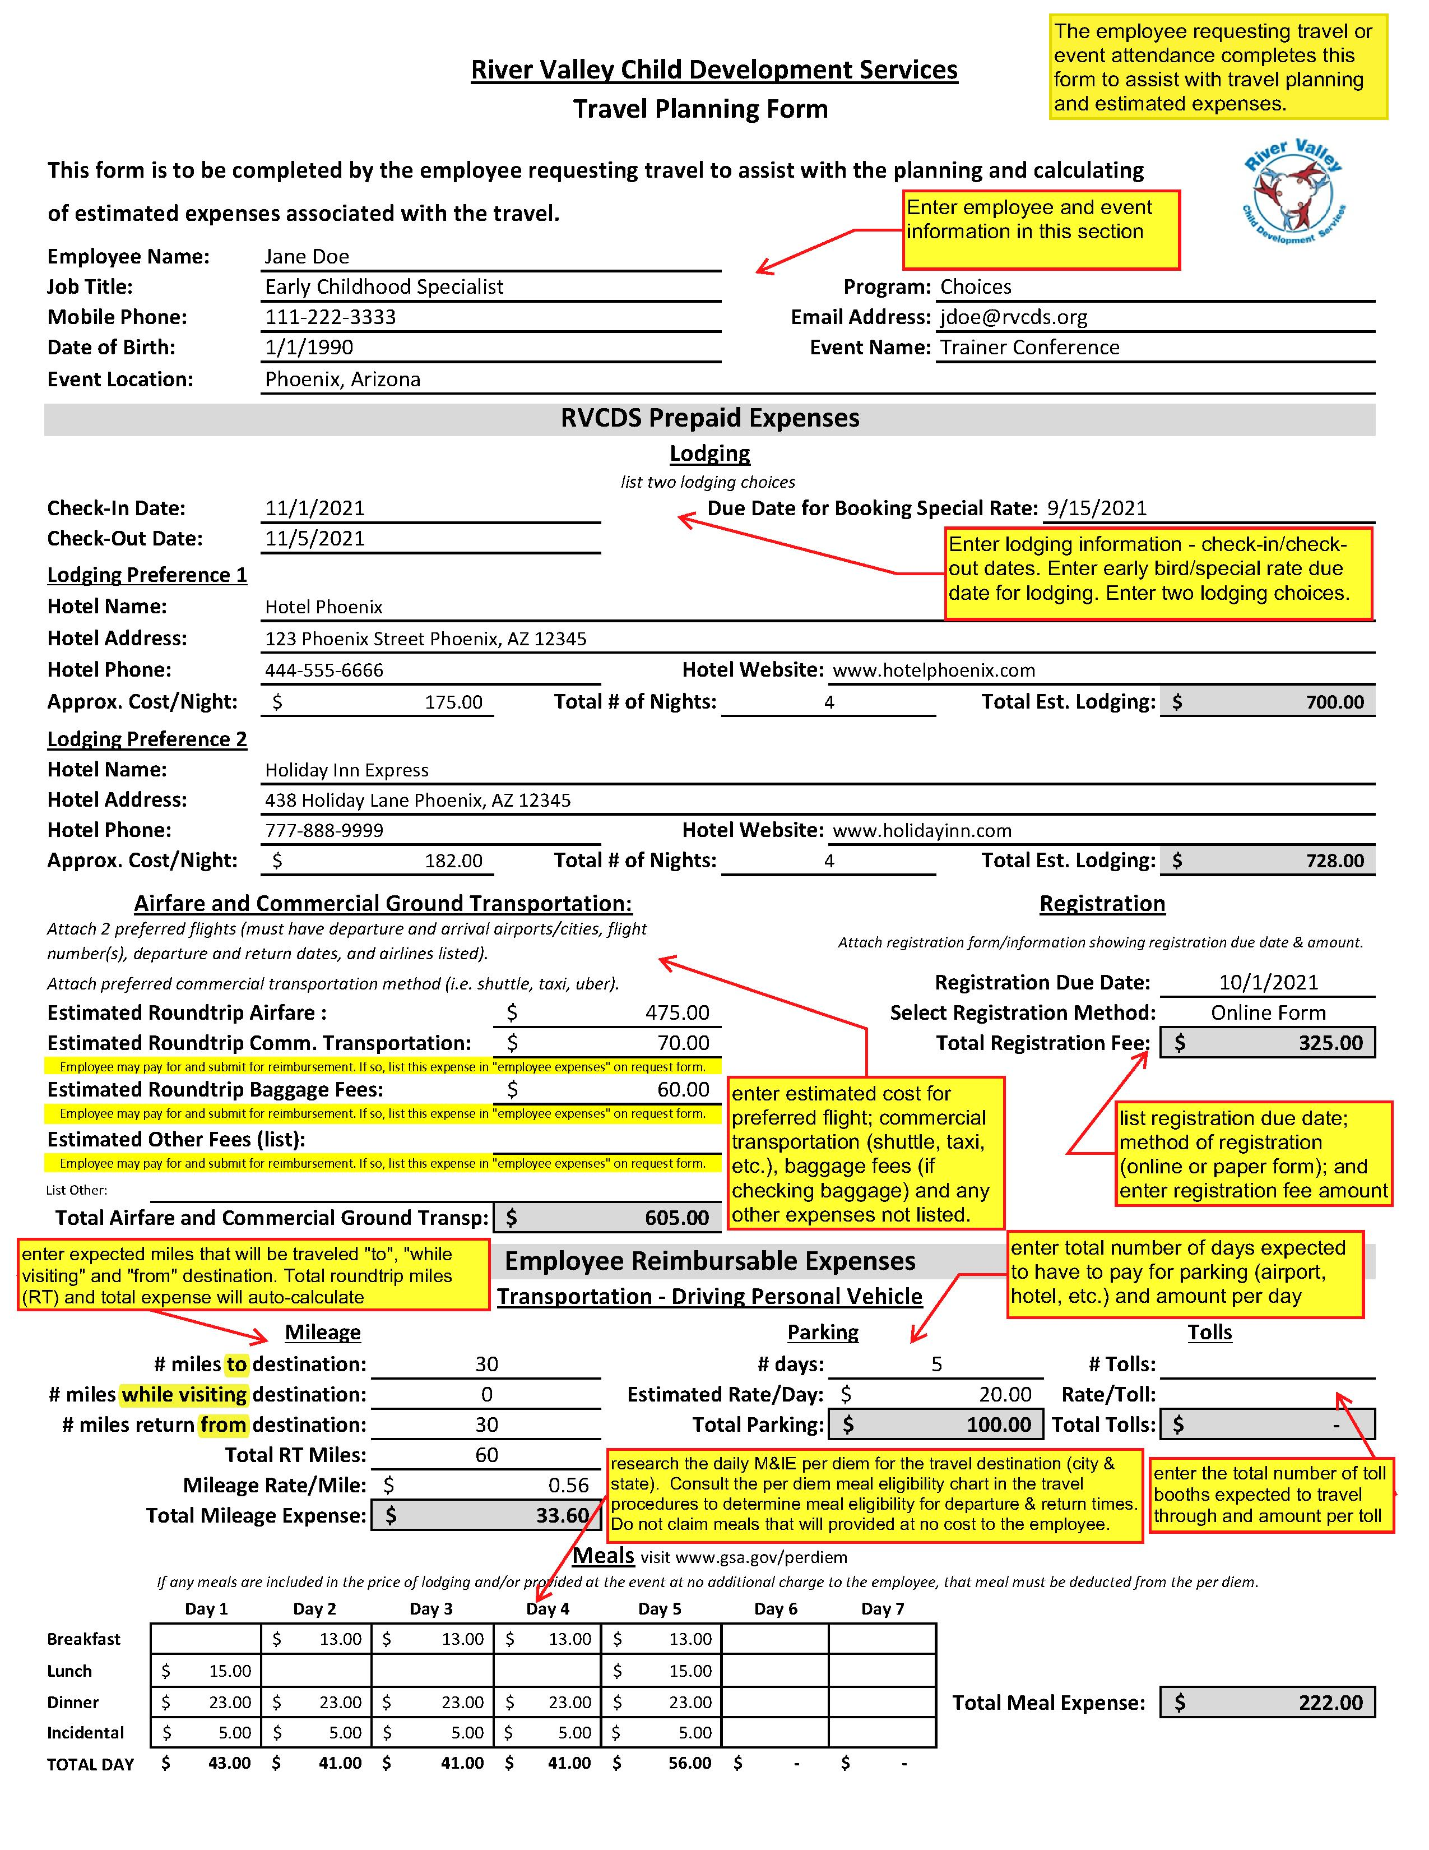
Travel Planning
Traveler will utilize the RVCDS Travel Planning Form to assist with determining estimated expenses

Slide 21
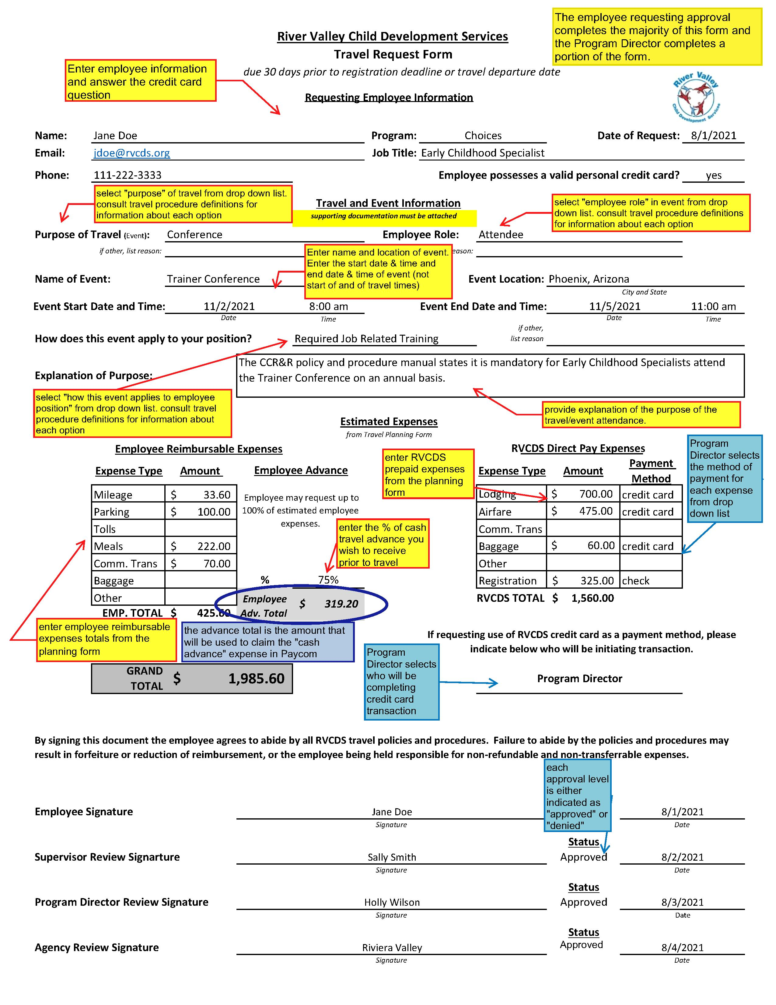
Travel Request
Traveler will complete the Travel Request Form and submit to Direct Supervisor/Program/Agency for review and approval.
The approved form is used to request a cash advance in Paycom.

Slide 22
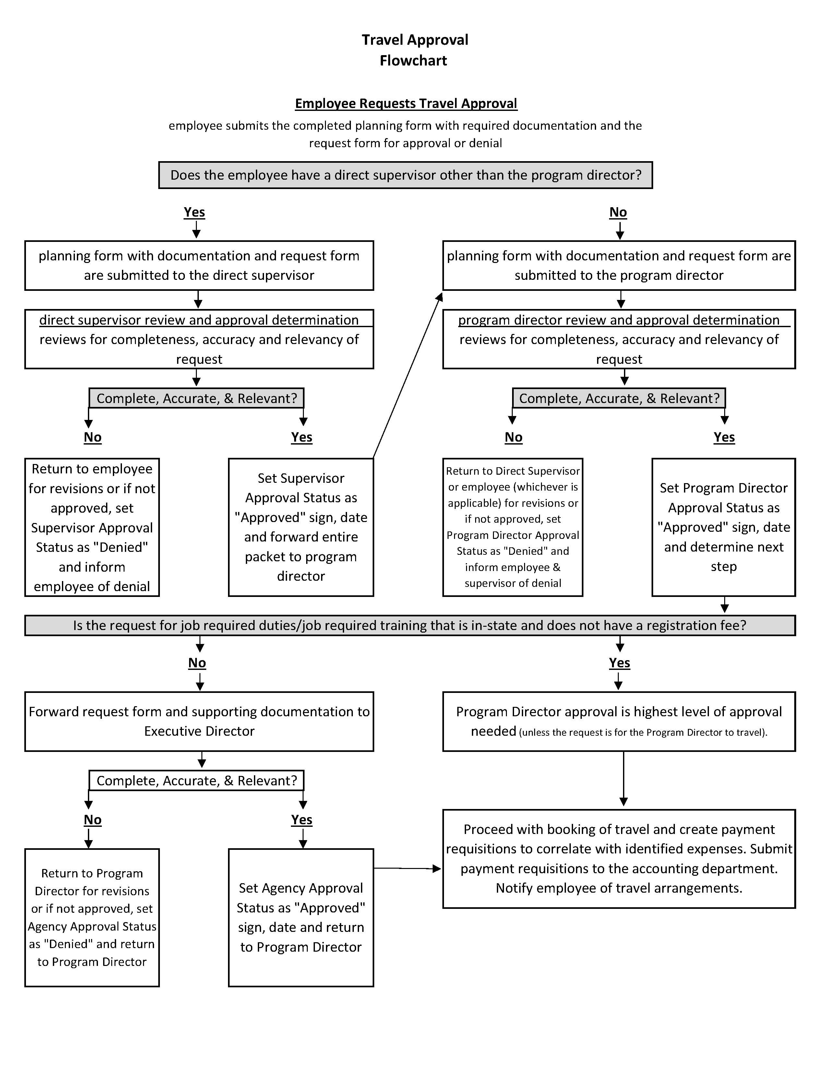
Travel Approval Flowchart
Consult the Approval Flowchart to determine approval/denial process for requests

Slide 23
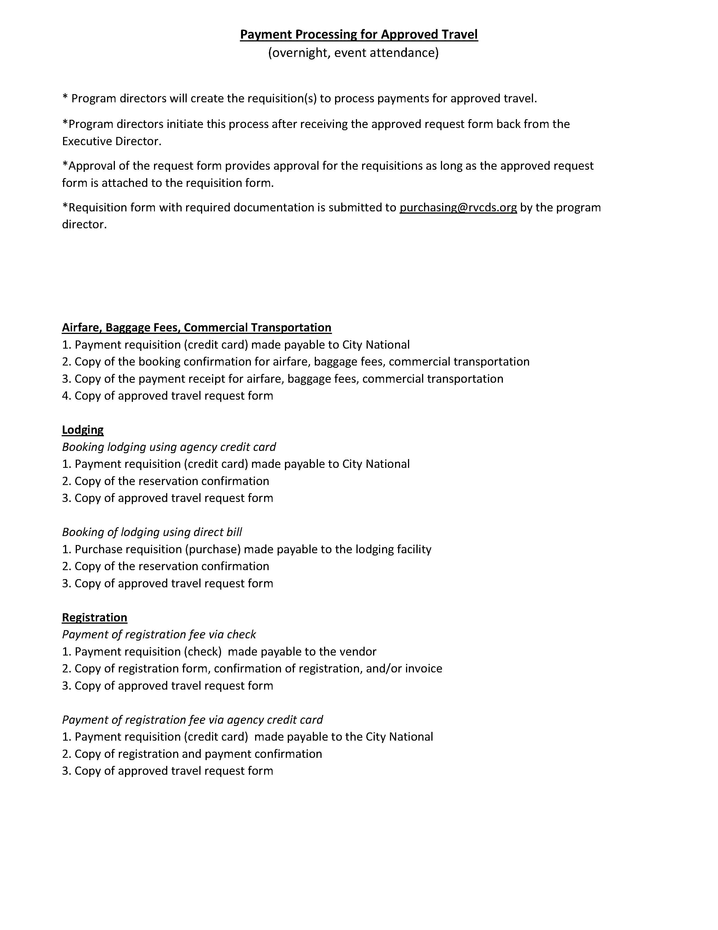
After Approval – Booking Travel and Processing Payments (Program Directors)
Consult the Payment Processing Outline for guidance on processing payment requests for travel and event attendance. Notify traveler of travel arrangements.

Slide 24
Travel Expense Reimbursement
Meal receipts are not required
Forms and Documentation
Travel Expense Reimbursement (TER) – traveler completes
Submission and Approval
Traveler submits to Direct Supervisor and Program Director for review and program level approval and expense coding within 5 days after return travel date
Payment
Log mileage, parking, tolls, meal per diem allowance, baggage fees, and commercial transportation expenses related to travel
Standard tool of measurement to calculate miles
Itemized receipts required for parking, toll expenses, commercial transportation, baggage fees
Employee submits approved expense report in Paycom using the overnight travel expense claim category.
Paid on the paycheck following submission and approval of expense claim
Paid via direct deposit to employees
Paid via check to non-agency travelers
Check or money order if a portion of cash advance must by repaid to RVCDS

Slide 25
Cancellations
If a cancellation charge is incurred, the charge will be covered by RVCDS if the traveler is directed by RVCDS to change his/her travel plans, or if other extenuating circumstances beyond the traveler’s control arise.
Travelers who change his/her travel plans for personal reasons will be responsible for all non-refundable, non-transferable charges associated with the travel. RVCDS may require the traveling employee to complete an assignment of wages form to withhold the expenses from the employee paycheck, or other alternative repayment methods may be made.

Slide 26
Other Important Information
Section 9 of the Travel Policy Procedure details roles and responsibilities for
Travelers
Supervisors
Program Directors
Executive Director
Director of Operations
Accounts Payable
Quality Assurance

Slide 27
Other Important Information
Section 10 of the Travel Policy Procedure details forms related to travel
Mileage Log
Section 11 of the Travel Policy Procedure details definitions related to travel
Traveler
Travel Planning Form
Travel Request Form
Travel Expense Report
Payment Requisition
Employee assigned worksite
Temporary worksite/work location
Commute
Daily transportation
Overnight travel
Personal vehicle
Standard tool of measurement
Documentary evidence
E-Zpass
Purpose of Travel
Employee Role
How the event applies to employee position
Extended workday travel
Event attendance travel

Slide 28

Safe Travels!
Contact Director of Operations with questions
304-523-3417 x 3452

